Slide 1
Introduction to Social Work
Dr. Imran A. Sajid
DSW|UOP
imranahmad131@uop.edu.pk
Karla Miley and Brenda Dubois, Social Work: An Empowering Profession

Slide 2
Imagine a society where

Slide 3

Everybody is YOUNG?

Slide 4
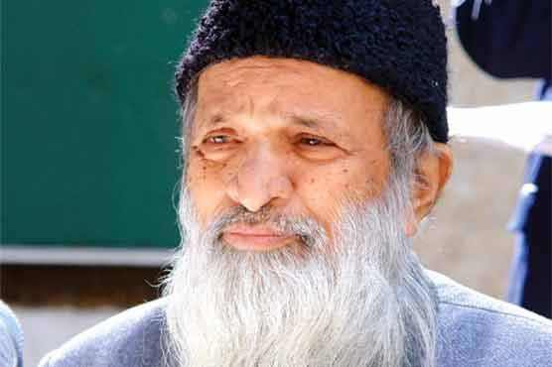
Nobody is OLD?

Slide 5


Everybody is WEALTHY?

Slide 6


Everybody is HEALTHY:?

Slide 7

Everybody gets the DREAM JOB?

Slide 8

No DRUG ABUSE problem?

Slide 9
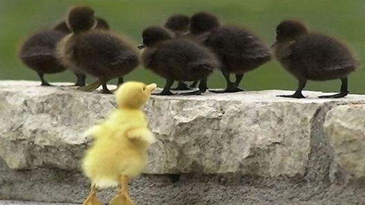
No DISCRIMINATION?

Slide 10

No CRIME?

Slide 11
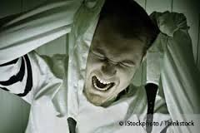
No MENTAL HEALTH Problems?

Slide 12
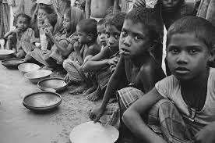
No POVERTY?

Slide 13
No!
Because human societies are not perfect.

Slide 14
Do you feel concerned when

Slide 15
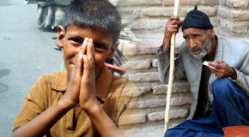
You see people beg in the street?

Slide 16
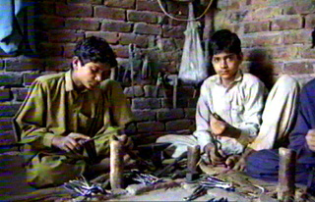
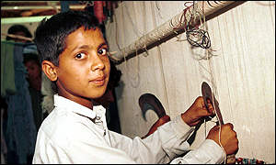
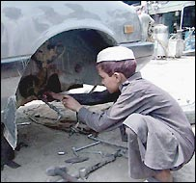
Children do not go to school and work as a labour?

Slide 17
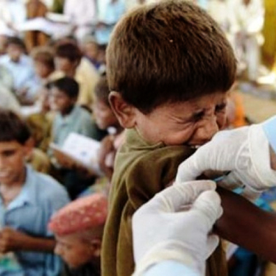
Poor go untreated because health care is not AFFORDABLE?

Slide 18

When you see domestic violence?

Slide 19
If yes then
WELCOME
TO
SOCIAL WORK
&
SOCIAL WELFARE

Slide 20
Social Work is a professional activity that aims to assist people in overcoming serious difficulties in their lives by offering care, protection and counseling.
    C. Hanry and Philpot. (1994). Practicing Social Work. London: Rutledge.

Slide 21
Definition by
IFSW and IFSSW
Social Work profession promotes social change, problems-solving in human relationships & the empowerment and libration of people to enhance well-being.
Utilizing theories of human behaviour and social system, social work intervenes (مداخلت) at the point where people interact with their environment.
Principles of human rights and social justice are fundamental to social work.
    IFSW and IFSSW. (2000). International Journal of Social Work. Vol: 47-3. pp-407-424.

Slide 22
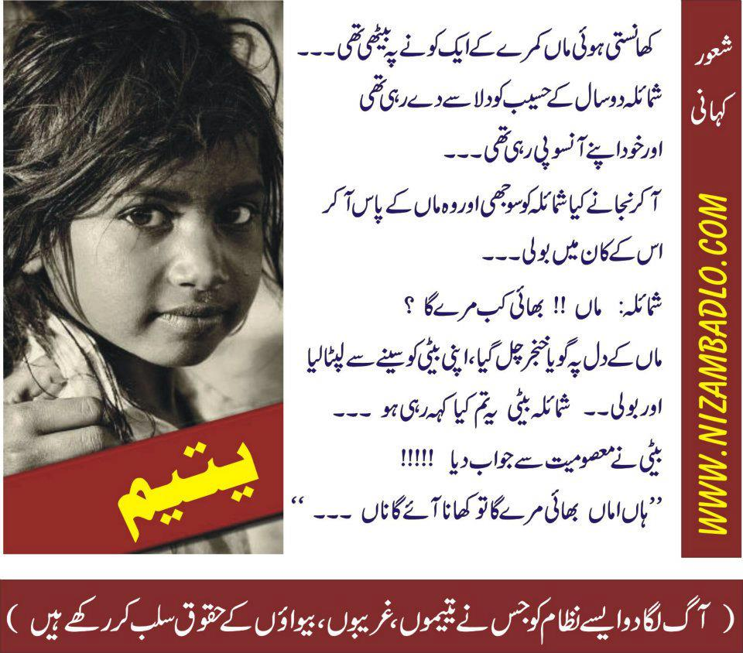
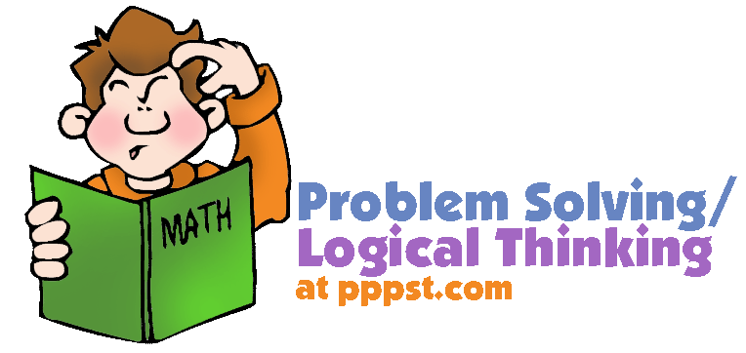
Social Work Profession
Promote
Social Change
Problem-Solving in Human Relationships
Problems
Enhance
Well-being
Liberation
Empowerment
People
Notes:
Social, Economic, Psychological, Spiritual, and Medical State of being good.

Slide 23
Social, Economic, Psychological, Spiritual, and Medical State of being good

Slide 24


Utilizing Theories
Theory is an Explanation of Facts
Human Behaviour
Social System
i.e.
i.e.
Psychology
Sociology
Intervention
Where people interact with their environment

Slide 25
Interaction
Inter
Action
+
=
Interaction
Between, Among, Mutual
Activity
Activity between two people or objects (or any of two things)

Slide 26
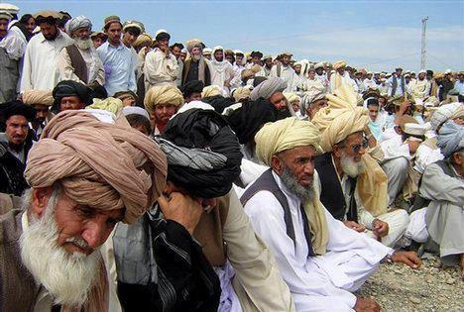

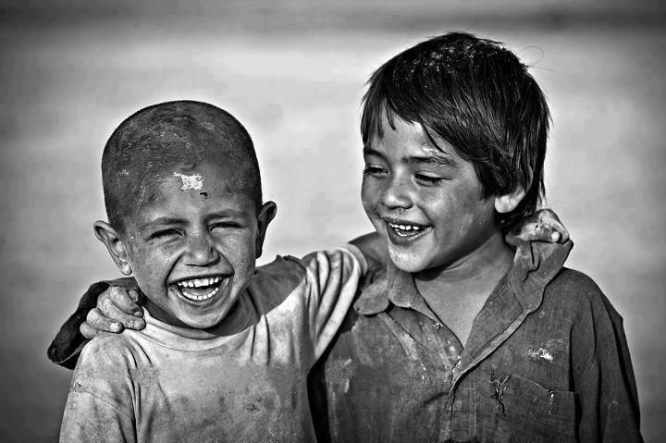
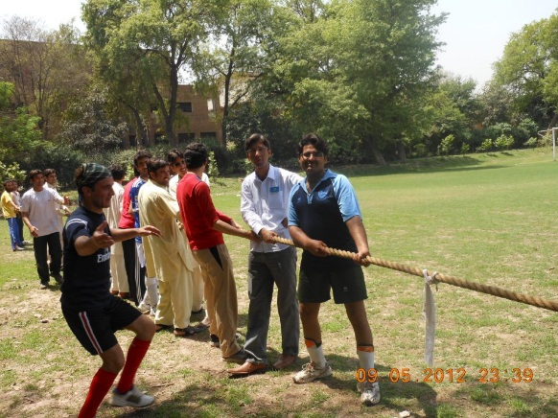
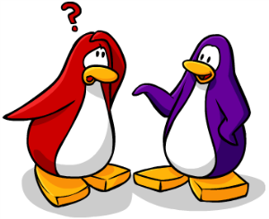
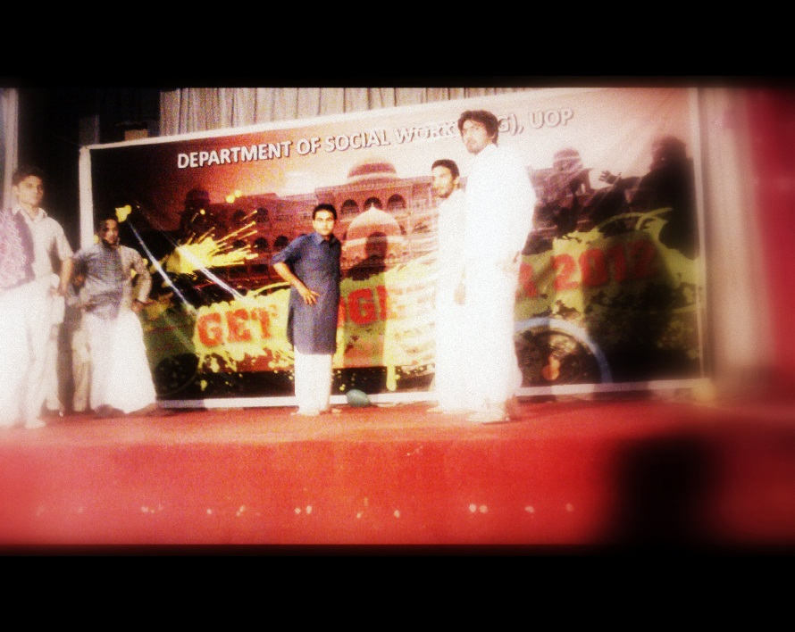
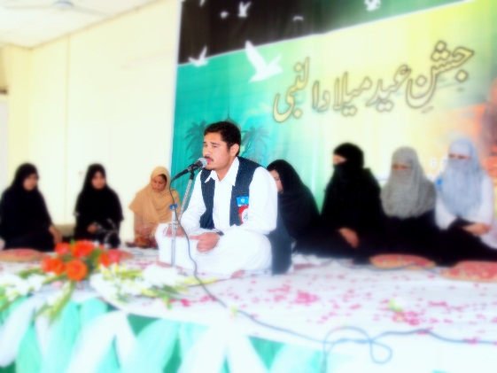
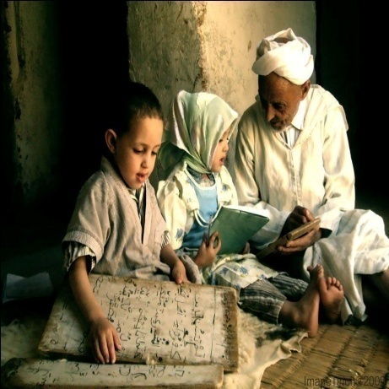
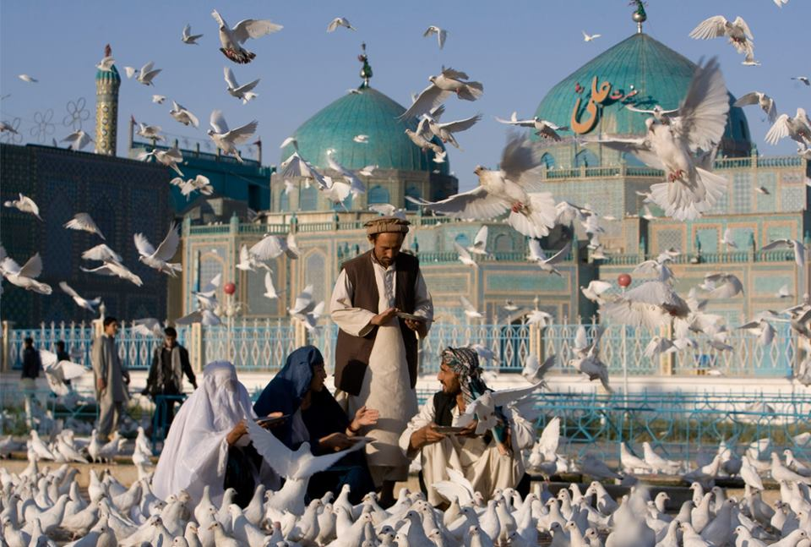
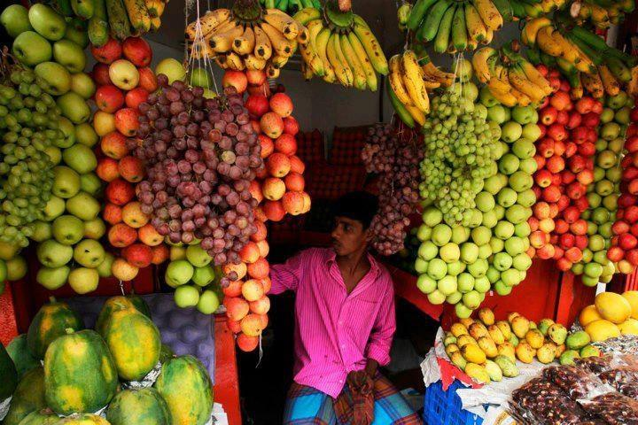
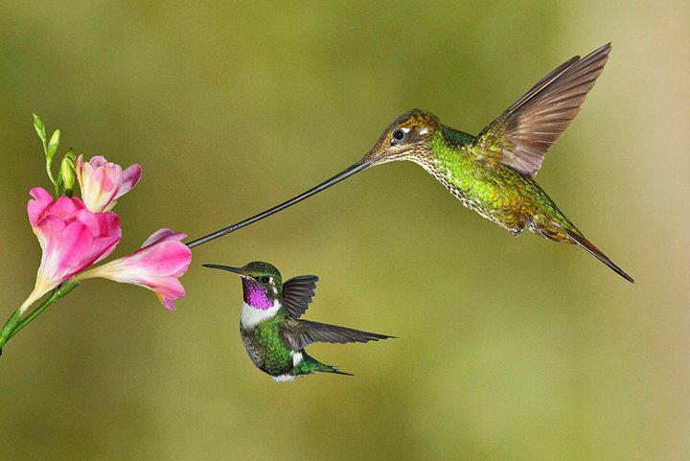
Examples of INTERACTION

Slide 27
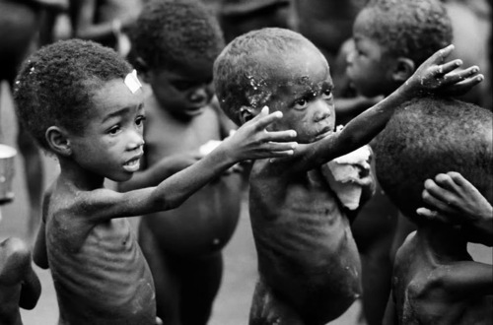
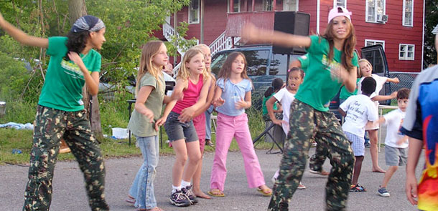
Fundamental Principles
Human Rights
Social Justice

